Slide 1
Chemical Bonding & Molecular Structure

Slide 2
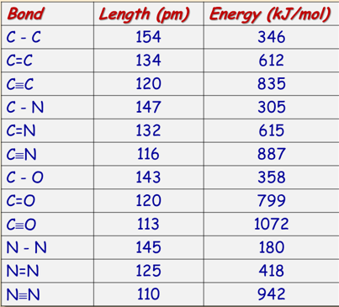
Chemical Bonds
There are 2 extreme forms of connecting or bonding atoms:
Ionic—complete transfer of electrons from one atom to another
Covalent—electrons shared between atoms
When atoms interact to form a chemical bond, only their valence electrons are in contact.
The formation of chemical bond always releases energy.
Once a bond is formed, bond energy is needed to break the bond apart.
The energy released when the isolated atoms form a covalent bond is called the bond energy.
The distance between the nuclei of the bonded atoms is called bond length.

Slide 3
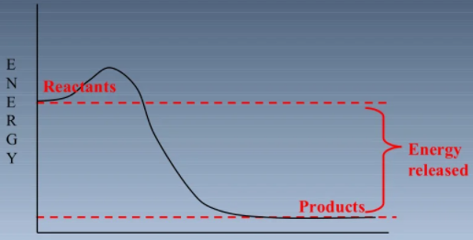
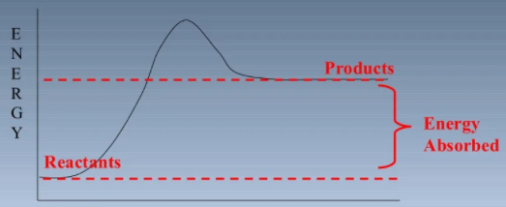
Bond formation & Bond cleavage
Bond formation is an exothermic process
Bond cleavage- endothermic process
Energy must be put into the bond to break it

Slide 4
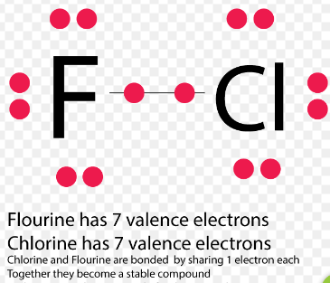
Octet rule
American chemist Gilbert Lewis - atoms combine to achieve a more stable electron configuration.
Maximum stability results when an atom is isoelectronic with a noble gas.
An atom will form covalent bonds to achieve a compliment of 8 valence electrons. This is called Octet rule.
The rule applies to main group elements (C, N, O, Halogens) and metals (Na, Mg)

Slide 5
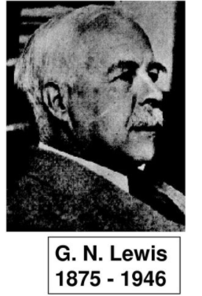
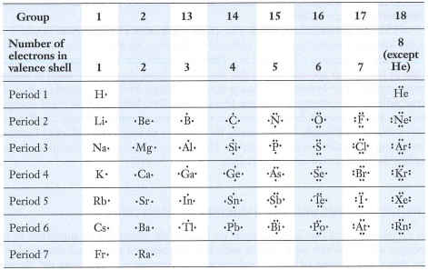
Lewis electron dot diagram
The basic concept of Octet rule can be depicted using a Lewis dot symbol.
The Lewis electron dot diagram is a way to:
-picture the transfer or sharing of valence electrons
- track of electrons involved in chemical bonds.
In an electron dot diagram (Lewis structure),
the symbol of the element represents the nucleus of the atom plus its inner shells of electrons,
dots around the symbol stand for the valence electrons.

Slide 6
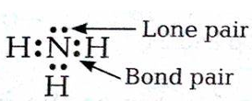
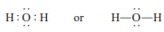
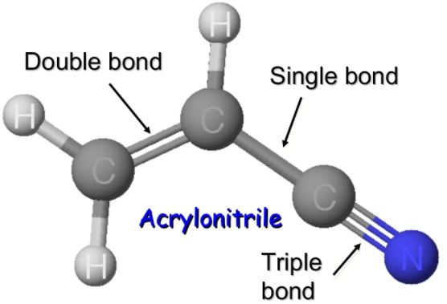
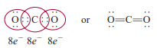
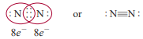
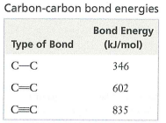
Lewis structure
Bonding pair
A pair of electrons shared by two atoms.
Lone pair
Pairs of valence electrons that are not involved in covalent bond formation.
Single bond_ One pair of electrons is shared
Double bond_ Two pairs of electrons are shared
Triple bond_ Three pairs of electrons are shared
Bond strength: Triple bond > Double bond > Single bong

Slide 7
Electronegativity
A property that helps us distinguish a nonpolar covalent bond from a polar covalent bond is electronegativity.
the ability of an atom to attract toward itself the electrons in a chemical bond.
Elements with high electronegativity have a greater tendency to attract electrons than do elements with low electronegativity.
electronegativity is related to electron affinity & ionization energy
High electron affinity (tends to pick up electrons easily)
e.g. halogens
High ionization energy (does not lose electrons easily)
e.g. Halogens

Slide 8
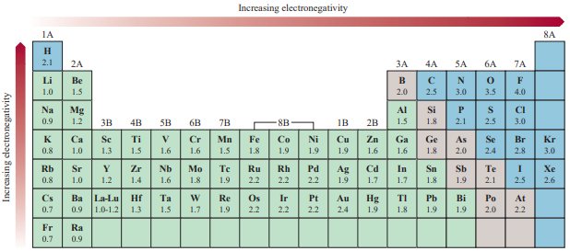
Period: EN increases from left to right as the metallic character of elements decreases.
Group: EN decreases with increasing atomic number, & increasing metallic character.

Slide 9
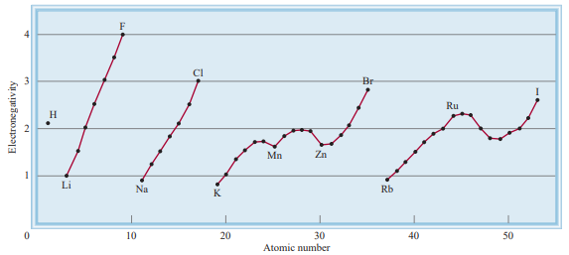

Slide 10
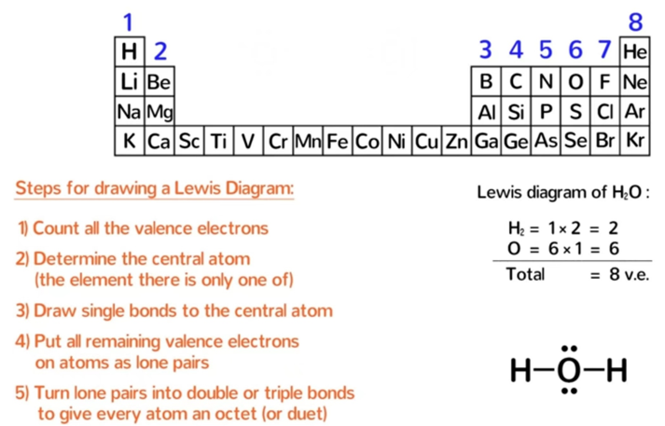
How to draw Lewis Structure?

Slide 11
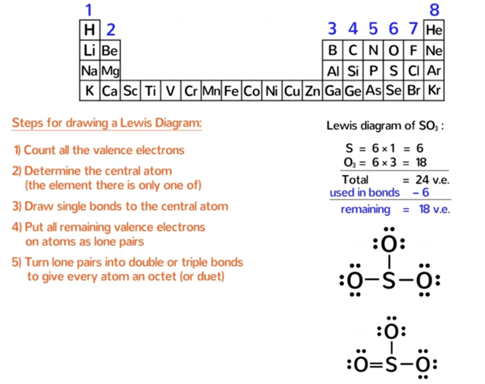

Slide 12
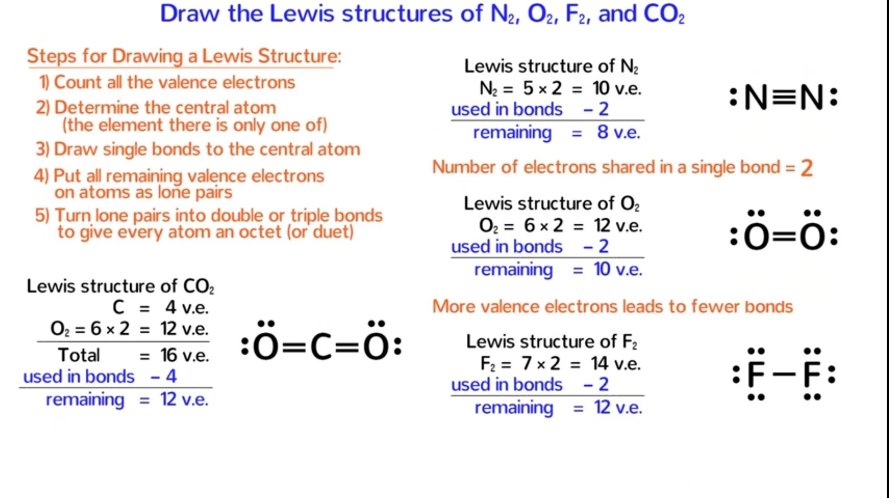

Slide 13
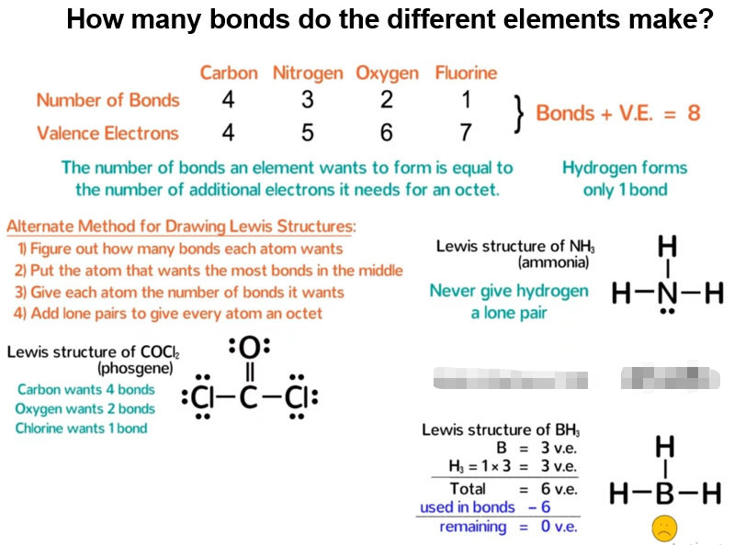

Slide 14
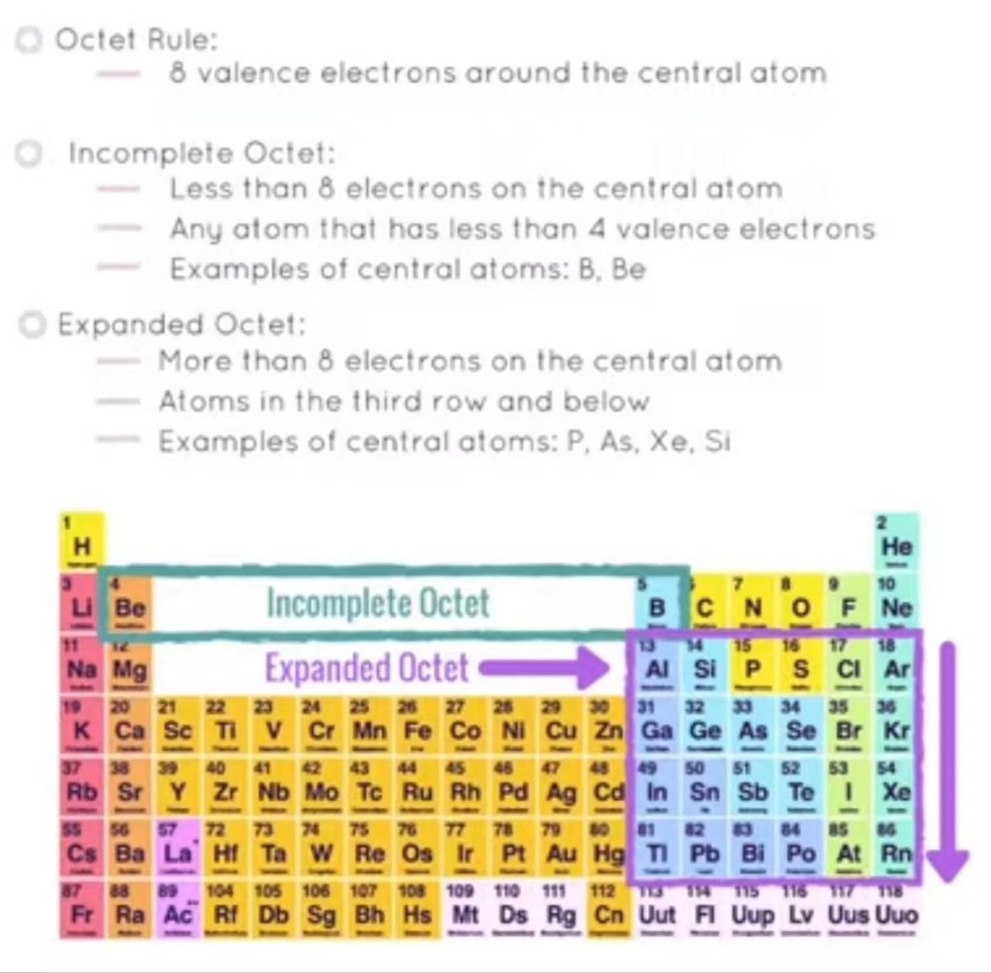
Exceptions of Octet rule

Slide 15
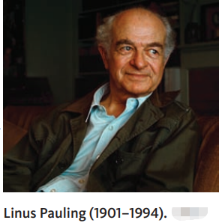
Bond Polarity
In the 1930s, Linus Pauling proposed a parameter called atom electronegativity (EN).
EN tells us
if a bond is polar,
which atom of the bond is partially negative & which is partially positive, &
if one bond is more polar than another.
Polar bonds form because one atom attracts the pair of electrons in a chemical bond more strongly than the atom to which it is bonded.
In a polar bond
the more electronegative atom takes on the partial negative charge,
the less electronegative atom takes on the partial positive charge

Slide 16
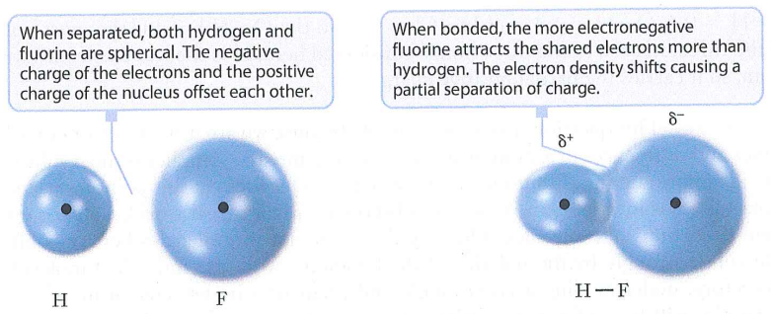
Bond Polarity… Cont…
F atom becomes partial –ve charge because it has more electron density than is necessary to balance its own nuclear charge.
H atom takes on partial +ve charge because it has insufficient electron density to balance its nuclear charge.

Slide 17
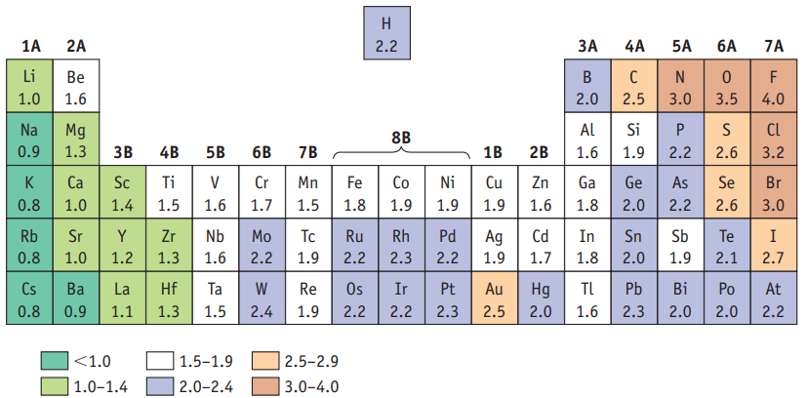
Estimating Bond Polarities
Problem: For each of the following bond pairs, which bond is more polar?
B - F and B – Cl
(b) Si - O and P – P
Practice exercise: Which bond is more polar?

Slide 18
Charge Distribution: Combining Formal Charge and Electronegativity
The way electrons are distributed in a molecule or ion is called its charge distribution.
It can affect the properties of a molecule.
Linus Pauling _ RULES for charge distributions in molecules & ions.
Electrons will be distributed in such a way that the charges on all atoms are as close to zero as possible (electroneutrality principle).
if a negative charge is present, it should reside on the most electronegative atoms.
positive charges are expected on the least electronegative atoms.

Slide 19
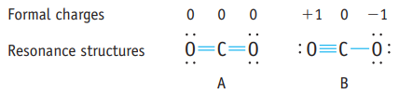
Charge Distribution… Cont.
CO₂
Favourable
Less satisfactory
Follows principal of electroneutrality
1+ charge on O …..
O has a greater electronegativity than C
Formal Charge (FC) = valence electron – (# of bond + dots)
Sum of formal charges = charge on the ion

Slide 20
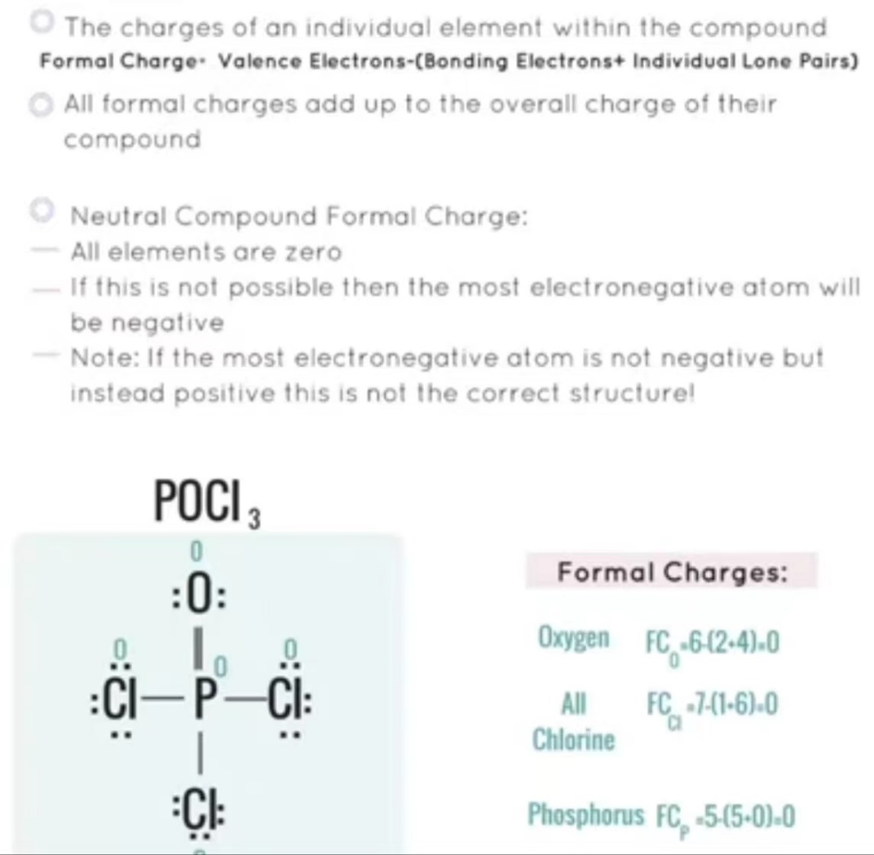
Formal charges for compounds
Draw Lewis structure of the following molecules/compounds with formal charges.
Ozone (O₃)

Slide 21
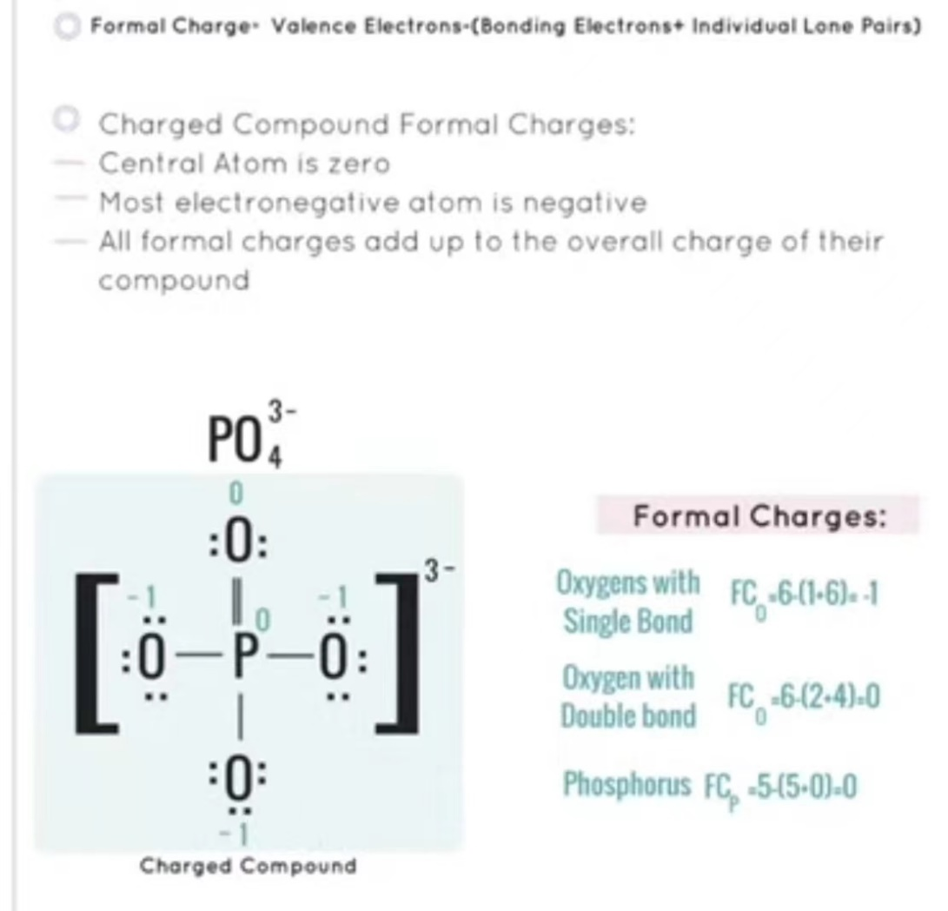
Formal charges for charged ions
cyanate ion, NCO⁻

Slide 22
Electronegativity (EN) of elements

Slide 23
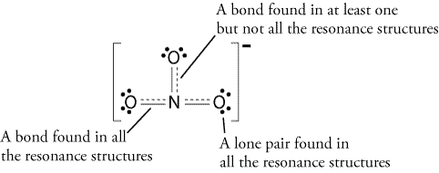
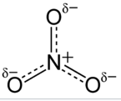
Resonance structure
Resonance: The movement of electrons from one atom to another on the same molecule (vibration of electrons).
Resonance structures are sets of Lewis structures that describe the delocalization of electrons in a polyatomic ion or a molecule.
In resonance structure,
the position of all atoms are identical,
only the positions of the electrons are different.
Example: NO₃⁻
Fractional bonds

Slide 24



+
Dinosaur (恐龙)
Unicorn (独角兽)
Rhinoceros (犀牛)

Slide 25
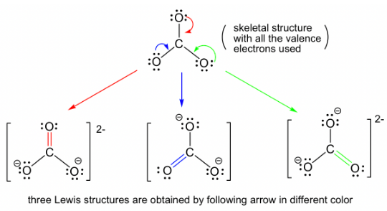
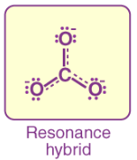

Resonance structure
Carbonate anion, CO₃²⁻
Fractional bonds

Slide 26
Rules for resonance structure
A structure with complete octets is usually more stable, except “Exceptions to the Octet Rule”.
A structure involving the smaller formal charges is more stable.
Negative charges should be preferentially located on atoms with greater EN.
Positive charges should be preferentially located on atoms with less EN
Charge separation decreases the stability (increases the energy).

Slide 27
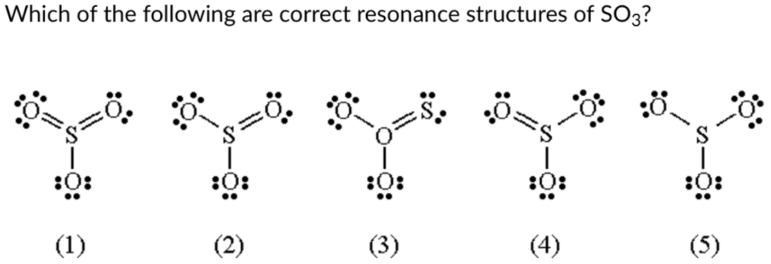

Slide 28
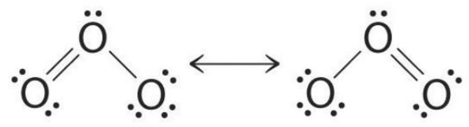
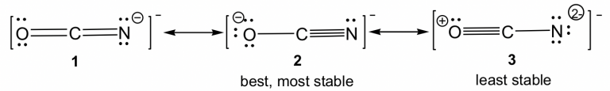
What is the most stable resonance structure？
O₃
OCN–

Slide 29
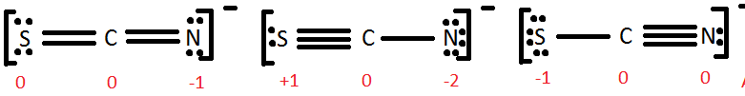
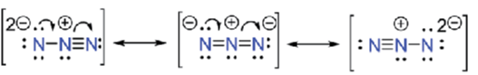
Draw Lewis structure and identify the most stable resonance structure.
Thiocynate (SCN–)
Azide (N₃–)
Most favorable
Least favorable
Favorable
Most favorable

Slide 30
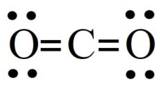
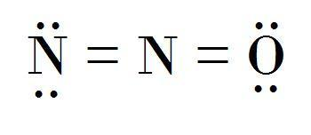
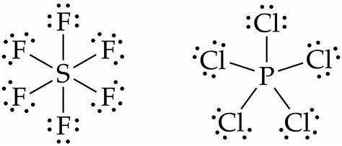
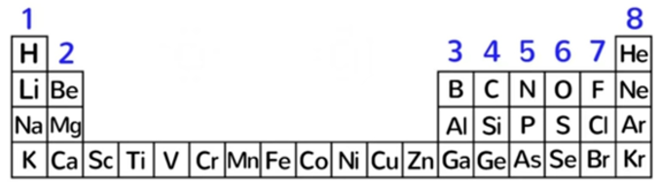
Multiples of 8 technique
Multiples of 8
Whenever a molecule, compound or ion has a multiple of 8 electrons, and if there is no H atom attached to the central atom, there will be no lone pair on its central atom.
If its not multiple of 8, then there will be lone pair on the central atom, except H atom attached to the central atom.
8
16
24
32
40
48

Slide 31
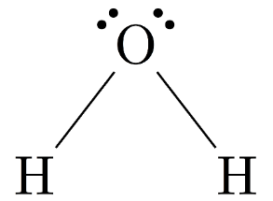
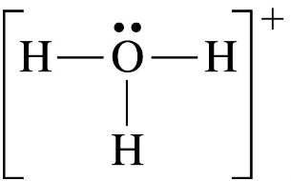
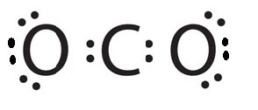
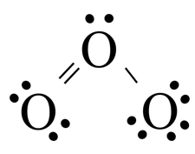
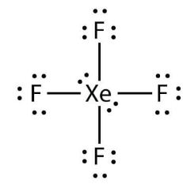
Practice exercise
H₂O
Hydronium ion (H₃O⁻)
CO₂
O₃ (ozone)
XeF₄ (Xenon tetrafluoride)

Slide 32
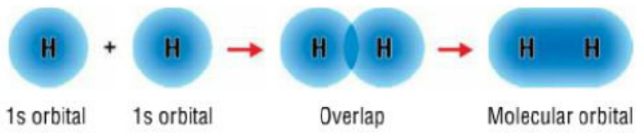
Orbital overlap
In chemical bonds, an orbital overlap can be defined as the merging of orbitals on adjacent atoms in the same regions of space.
Orbital overlap can lead to bond formation.
When two atoms come nearby they penetrate each other’s orbital forming a new hybridized orbital, known as orbital overlap.
This hybridized orbital is stable since it is in the lower energy state.

Slide 33
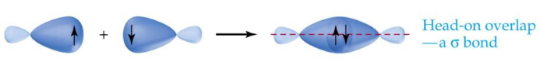
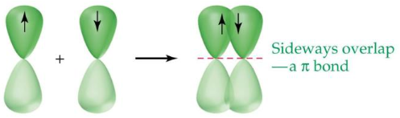
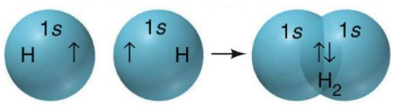
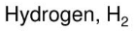
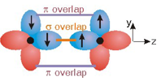
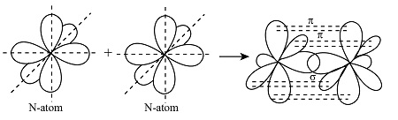
Two types of overlapping areas in the orbitals are sigma (σ) and pi (π).
Single bonds contain one σ bond.
Double bonds contain one σ and one π bond,
Triple bonds consist of one σ and two π bonds.
σ is stronger than π bond due to greater extent of overlap.
End-to-end overlap (σ bond)
Side-to-side overlap (π bond)
O₂ molecule
N₂ molecule

Slide 34






Bond strength

Slide 35


Hybrid orbitals (hybridization)
A hybrid orbital is an orbital formed by the combination of two or more atomic orbitals.
Hybridization is the mixing of atomic orbitals in an atom (usually a central atom) to generate a set of hybrid orbitals.
The resulting orbital has a different shape and energy than the component orbitals that form it.
Hybridization is used to model molecular geometry and to explain atomic bonding.
e.g. orbitals around berylium in BeF₂
Hybridization of C (Z=6) atom
sp hybridization

Slide 36







Hybrid orbitals (hybridization)
sp hybridization:
e.g. BeCl₂
Valence electrons of Be atom
Promotion of 2s electron to 2p orbital
Hybridization of 2s and 2p orbitals

Slide 37


sp² hybridization
BF3 (boron trifluoride):
The sp² hybrid orbitals of B overlap with the 2p orbitals of F.

Slide 38





sp³ hybridization
e.g. CH₄ molecule
Valence electrons of C atom
Promotion of 2s electron to 2p orbital
Hybridization of 2s and 2p orbitals

Slide 39



sp³d and sp³d² Hybridization
These hybridizations are only possible for atoms that have d orbitals in their valence subshells (that is, third or onward period).
sp³d
Phosphorus pentachloride, PCl₅:

Slide 40




sp³d²
SF₆ molecule
Square planar

Slide 41

Ignore double bonds, they count as one bonding pair!

Slide 42



Bonding patters

Slide 43

Shapes of molecules
Lewis structure explains number of bonds in a molecule and shows the bonding pattern.
However, Lewis structure gives incomplete, two-dimensional picture of molecular structure.
The shape of a molecule depends on the number of electron pairs in the valence shell around a central atom.
Molecular geometry or molecular shape is the three-dimensional (3D) arrangement of atoms within a molecule.
‘Valence shell electron pair repulsion (VSEPR) theory’
Molecular Shape is determined by the repulsions of electron pairs.
Electron pairs around the central atom stay as far apart as possible.

Slide 44

Valence shell electron pair repulsion (VSEPR) theory
In a polyatomic molecule, the repulsion between electrons in different bonding pairs causes them to remain as far apart as possible.
The geometry (shape) that the molecule ultimately assumes minimizes the repulsion.
VSEPR, accounts for the geometric arrangements of electron pairs around a central atom to minimize the electrostatic repulsion between electron pairs.
VSEPR model, based largely on Lewis structures, provides a relatively simple method for predicting the geometry of molecules or ions.

Slide 45



Molecules with no Lone Pairs on Central atom
Molecular shapes based on VSPER Theory
AXE system
e.g. AX₂, AX₃, AX₄, AX₅, AX₆
AX₂: Beryllium Chloride (BeCl₂)
Lewis structure
Because the bonding pairs repel each other, they must be at opposite ends of a straight line in order for them to be as far apart as possible.
Thus, the angle is predicted to be 180$°$, and the molecule is linear.
B.P+L.P
A is the central atom
X is the bonded atom with central atom
E is lone pair of electrons on the central atom

Slide 46


Molecules with no Lone Pairs on Central atom
AX₃: Boron Triﬂuoride (BF₃)
x
y
z

Slide 47


AX₄: Methane (CH₄)

Slide 48




Molecules with no Lone Pairs on Central atom
AX₅: Phosphorus Pentachloride (PCl₅)
The angle between any two equatorial bonds is 120$°$
Angle between an axial bond & an equatorial bond is 90$°$
Angle between the two axial bonds is 180$°$.

Slide 49





AX₆: Xenon tetrafluoride (XeF₄)
AX₆: Sulphur Hexaﬂuoride (SF₆)
An octahedron has eight sides
Because the six bonds are equivalent in an octahedral molecule, we cannot use the terms “axial” and “equatorial”

Slide 50



Bond angle
the angle formed between two covalent bonds that originate from the same atom.

Slide 51


Electronic geometry and molecular geometry

Slide 52
Molecules with one or more Lone Pairs on the Central atom
Determining the geometry of such molecule is more complicated.
In such molecules there are three types of repulsive forces:
those between bonding pairs,
those between lone pairs,
those between a bonding pair and a lone pair.
According to the VSEPR model, the repulsive forces increase in the following order:
Bond-pair electrons take up less space than lone-pair electrons.
LP electrons experience greater repulsion from neighboring LP & BP.
Generic AXE formula
A is the central atom,
X is a surrounding atom
E is a lone pair on A

Slide 53


Slide 54



AX₂E: Sulfur dioxide (SO₂)
BP+LP = 2+1 = 3
one of the electron pairs is a lone pair, the SO₂ molecule has a “bent” shape.
LP vs BP repulsion > BP vs BP repulsion, the two sulfur-to-oxygen bonds are pushed together slightly.

Slide 55



AX₃E: Ammonia (NH₃)
BP+LP = 3+1 = 4

Slide 56


AX₂E₂: Water (H₂O)
BP+LP=2+2 = 4
The geometry of H₂O is bent
The two LP force the angle down to 104$.5°$

Slide 57





AX₄E: Sulfur Tetrafluoride (SF₄)

Slide 58


AX₃E₂: Chloride Trifloride (ClF₃)

Slide 59

AX₂E₃: Xenon dichloride (XeCl₂)

Slide 60

A tricky example, BrF₃

Slide 61

A tricky example, ClF₃
V.e. = 7+3=10 e
BP+ LP = 3+2 = 5 pairs
There are following possible ways to arrange 3 BP and 2 LP.
The right arrangement will be the one with the minimum amount of repulsion.
T-shaped

Slide 62




Molecular geometry of ions
Ammonium ion, NH₄⁺
v.e. 5+4-1 = 8e
BP+LP = 4+0=4
NH₄⁺ is tetrahedral
NH₄⁺ has exactly the same shape as CH₄, because it has exactly the same electronic arrangement.
CH₄ and the NH₄⁺ are isoelectronic.
Hydroxonium ion, H₃O⁺
v.e. 3 + 6 – 1= 8e
Lewis structure:
BP + LP = 3+1=4
H₃O⁺ is Pyramidal
H₃O⁺ and the NH₃ are isoelectronic
Ammonia, NH₃

Slide 63


Molecules with More Than One Central Atom
The overall geometry of molecules with more than one central atom is difficult to define in most cases.
Often we can describe only the shape around each of the central atoms.
Example: Methanol, CH₃OH
Vinyl alcohol,
Molecular shape: Trigonal planar
Hybridization: sp² (each C)

Slide 64





Acetone, (CH₃)₂C$=$O
Ethane, C₂H₆
Tetrahedral
Ethanol, C₂H₅O
Tetrahedral

Slide 65








Trick to memorize the shapes of molecules
B.P
L.P
Square planar
2 1
2 2
2 3
3 1
3 2
4 1
4 2
5 1
B
Bent
L
Linear
Trigonal Pyramidal
T
T-shaped
See-saw
See-saw
S
Square Planar
Square Pyramidal
IF₅
T-shaped

Slide 66

Molecular shape & hybridization
Examples
BeCl₂, C₂H₂
AlH₃, CO₃²⁻
CCl₄, NH₃
PBr₅, ClF₃
SF₆, XeF₄

Slide 67
Practice exercise
Draw Lewis structure, identify molecular geometry and determine the hybridization of the Central atom in each of the following molecules.
Urea, NH₂CONH₂ 2) Acetic acid, CH₃COOH 3) SO₂ 4) PO₄³⁻
5) BCl₃ 6) AlI₃ 7) PF₃ 8) ClF₄⁻ 9) SiBr₄
(Aluminium tri-iodide)

